Slide 1
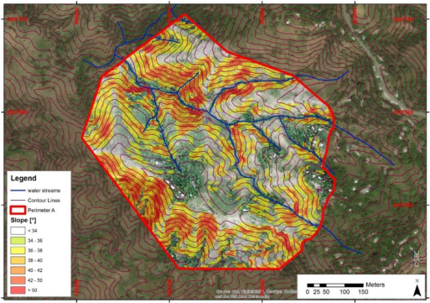
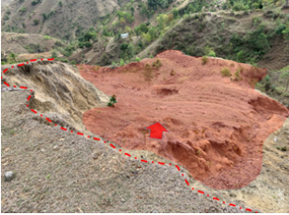
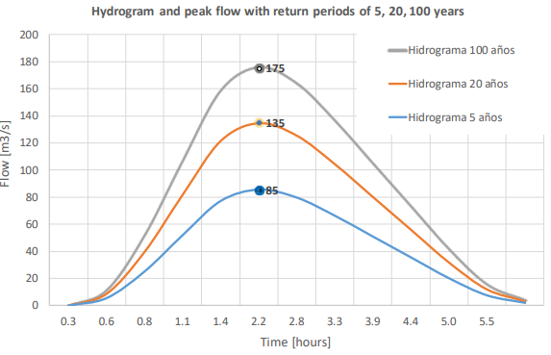
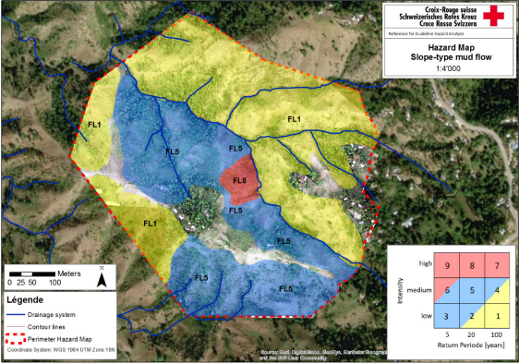
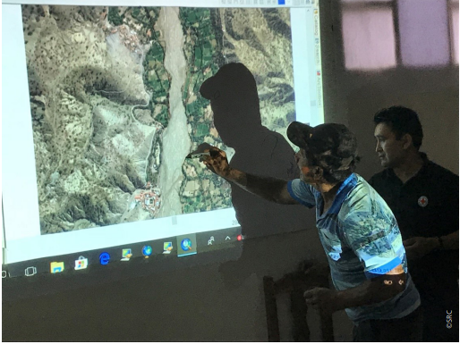
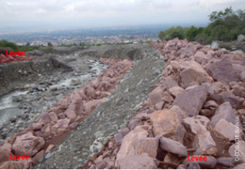
Learning Journey Hazard and Risk Assessment
‘Etiquette’
Plenary sessions are recorded
Keep mic muted, but keep camera on
Opportunities to ask questions by voice and through chat
Welcome

Slide 2
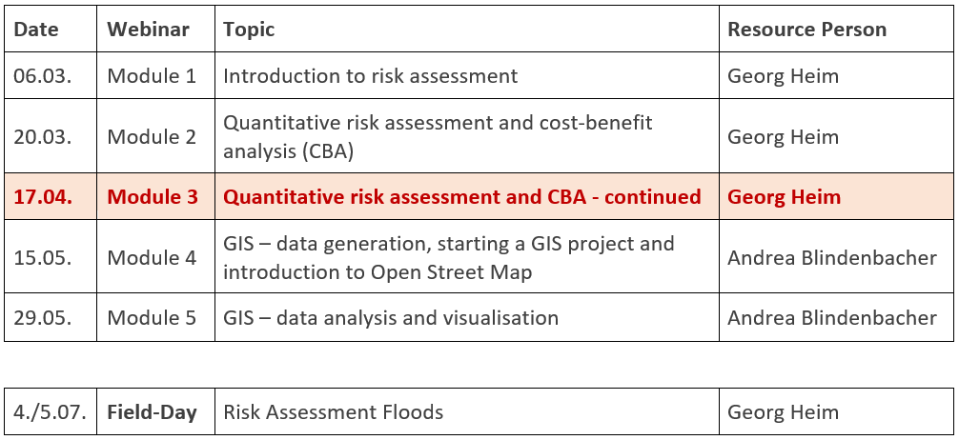
Learning Journey Hazard and Risk Assessment
Part II: Risk Assessment
Objective
Enhance the capacity of practitioners on how to:
independently conduct a risk assessment and determine the cost-benefit ratio of a DRR measure
work with GIS
Agenda

Slide 3
Goal and content of this module
Goals: The participants...
know the Risk Excel tool and MiResiliencia and can apply them
understand the concept of indirect risks and can apply it in cost-benefit calculations
receive answers to open questions on risk calculation
Content:
Exercise Risk and cost-benefit calculation of mitigation measures using Excel tool (group exercise)
Exercise Risk and cost-benefit calculation of protection measures using MiResiliencia (group exercise)
Q&A on risk analyses

Slide 4
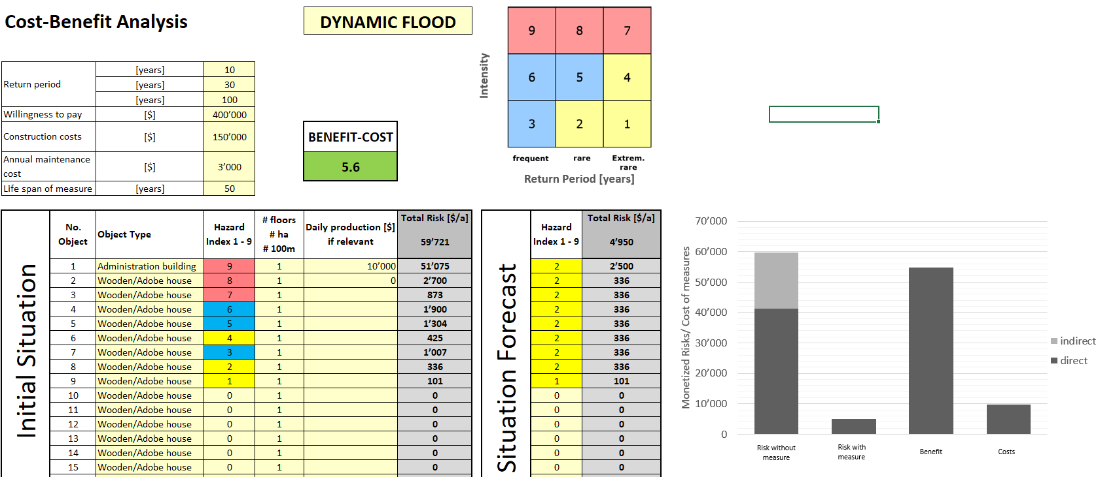
Repetition from Module 2 (Risk analysis based on Excel)

Slide 5
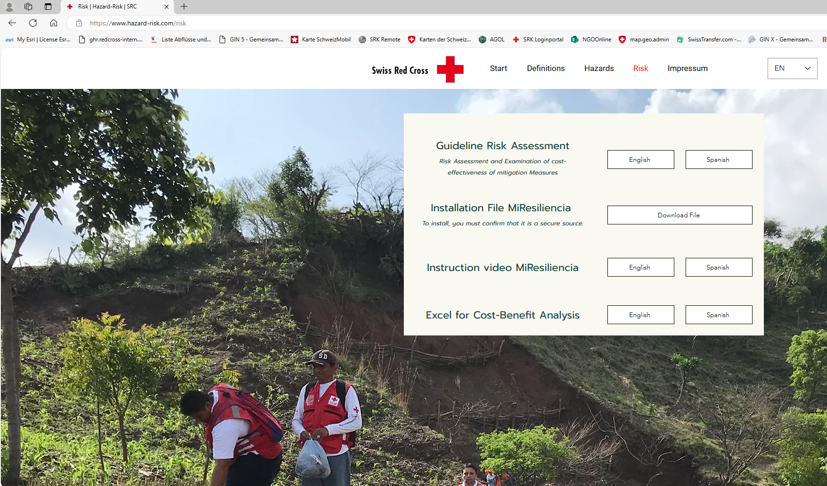
Website to download the excel calculation sheet
www.hazard-risk.com/risk
(website link in the chat)

Slide 6
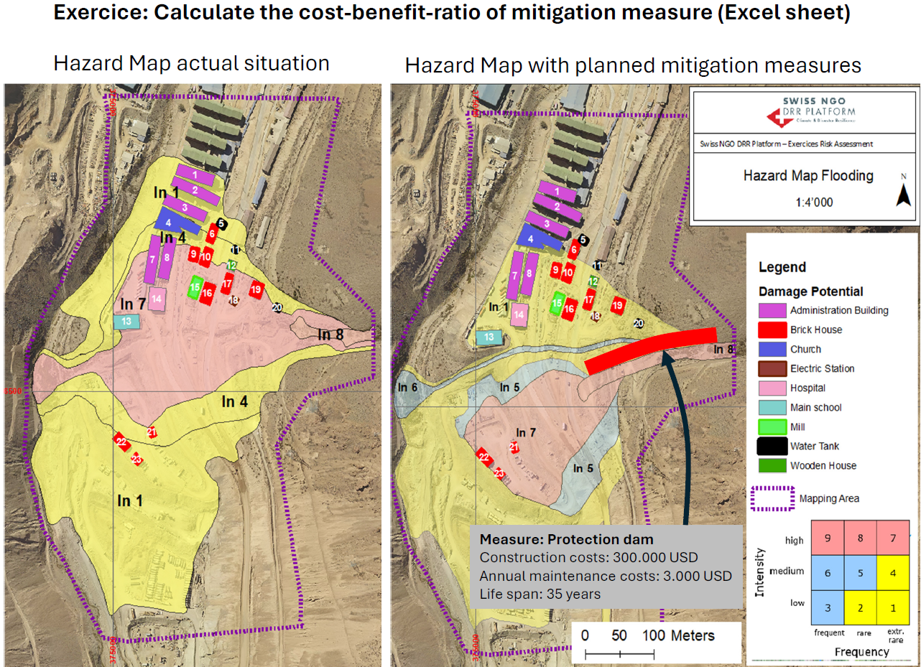
Introduction (Critical sites)

Slide 7
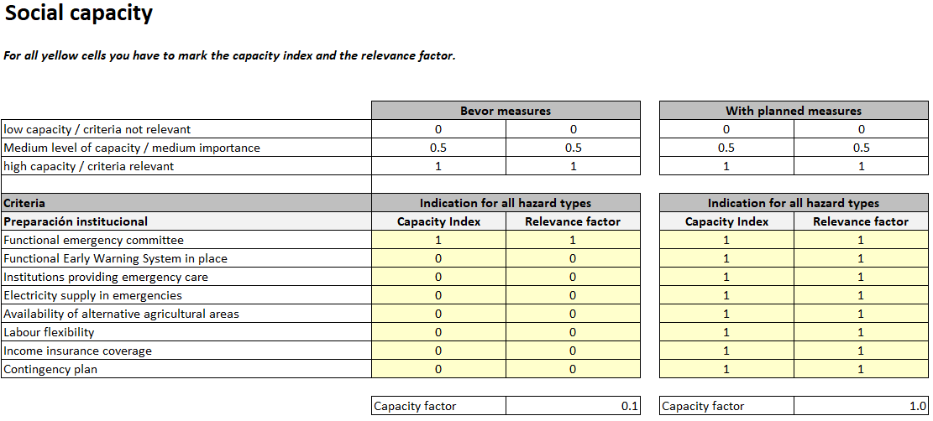
Indirect Risks (depend on social capacities)
Concept of calculation of indirect risks
$$\text{Indirect} \text{Risks}=\frac{\text{Lost} \text{of} \text{daily} \text{production}\text{[\$] ∗ }\text{days} \text{lost} }{\text{Social} \text{Capacity}}$$
Indirect risks only for objects with income generation (administration building, farmland, …)

Slide 8
MiResiliencia-Tool

Slide 9
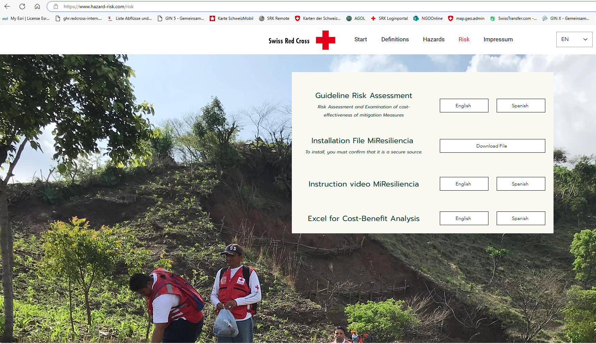
MiResiliencia-Tool
Have you already downloaded the MiResiliencia-File?

Slide 10
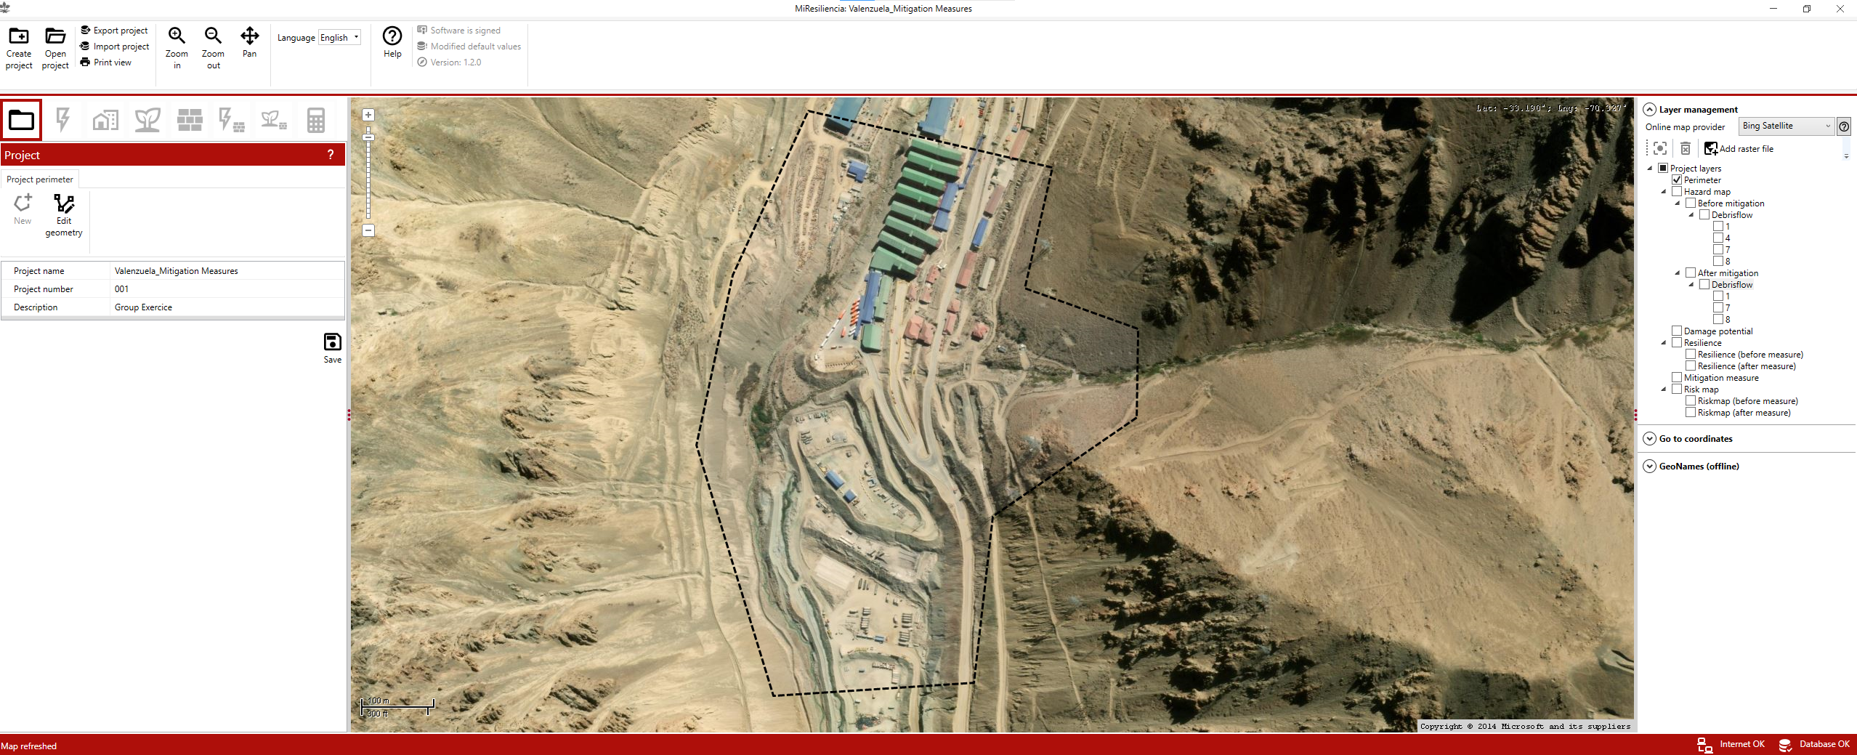
MiResiliencia-Tool
Explication from facilitator
Insert your own photos: Demonstration during the break

Slide 11
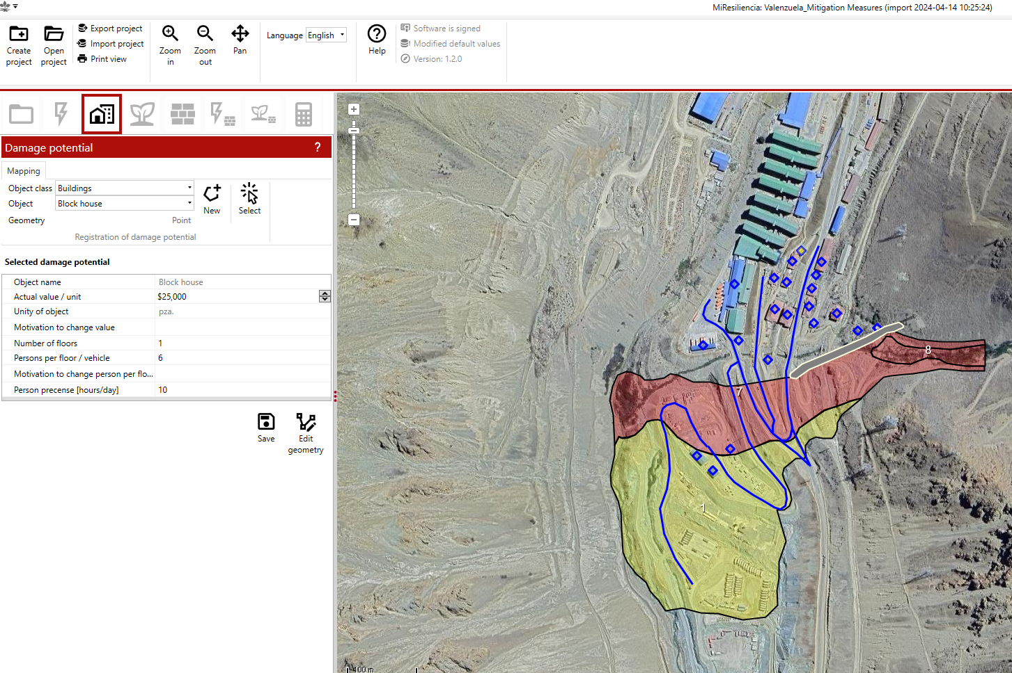
MiResiliencia-Tool – Exercice „damage potential“
Assign damage potential for the buildings with green roofs and specify their values

Slide 12
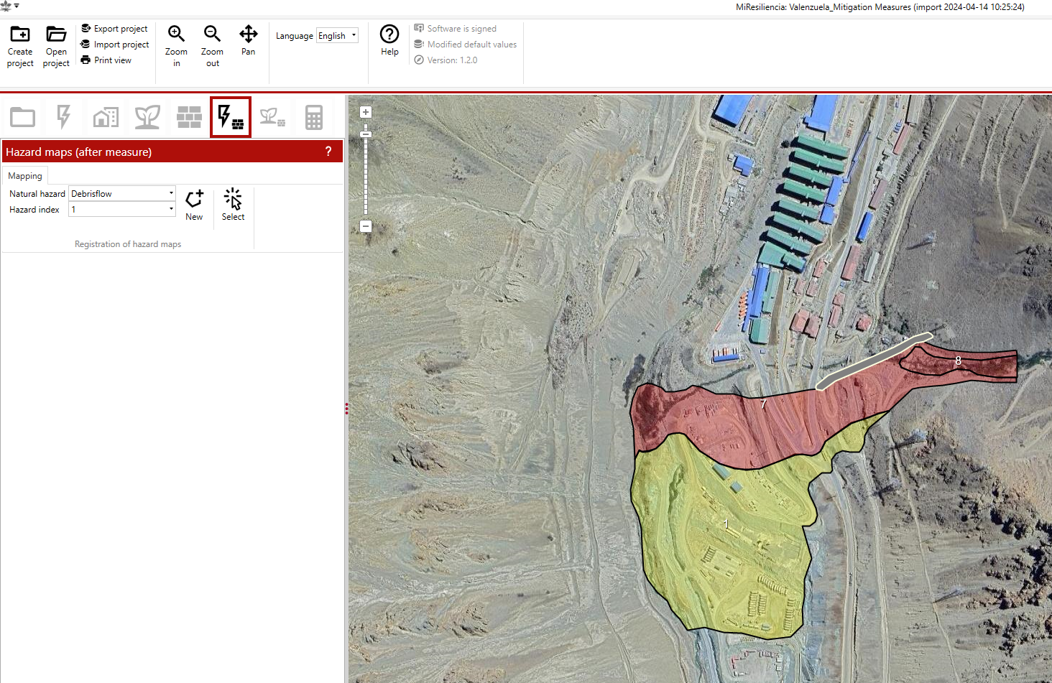
MiResiliencia-Tool – Exercice „hazard with measures“
Complement the hazard prone area behind the protection dam (Hazard Index In 1)

Slide 13
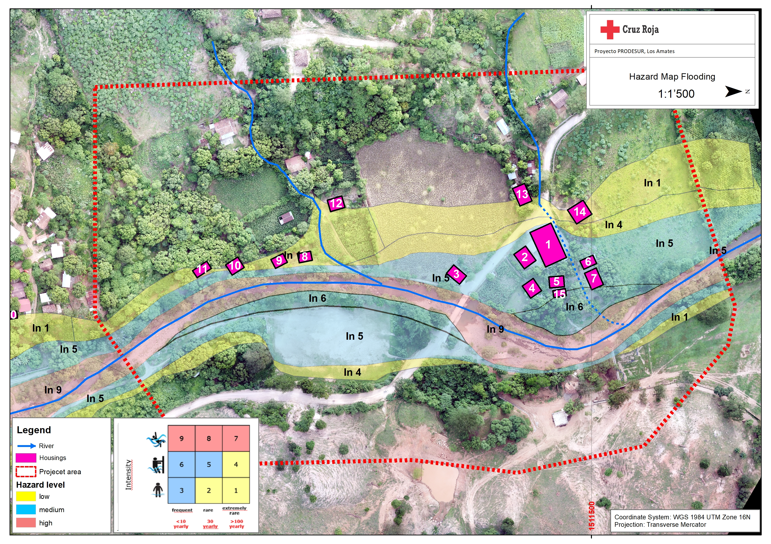
Exercice 3: Calculate the cost-benefit-ratio of mitigation measure (Excel sheet)
Before Measures

Slide 14
Exercice 3: Calculate the cost-benefit-ratio of mitigation measure (Excel sheet)
With Measures
Willingness to pay: 175.000 USD
Protection dam
Construction costs: 12.000 (USD)
Maintenance costos: 1.000 (USD/year)
Life span: 40 years

