Slide 1
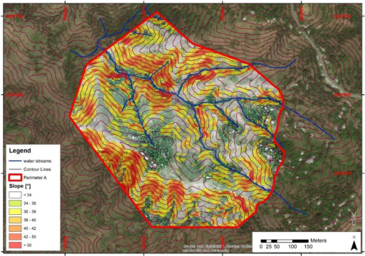
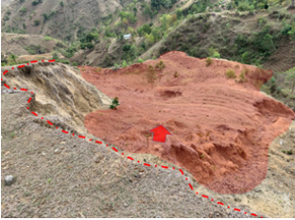
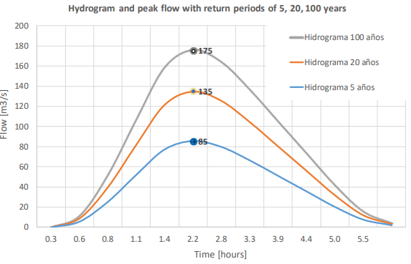
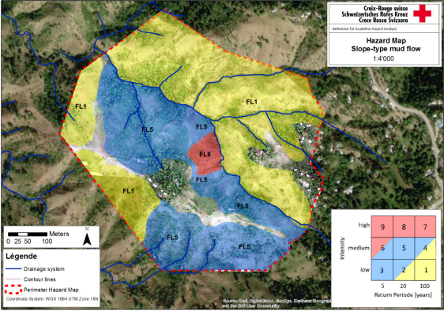
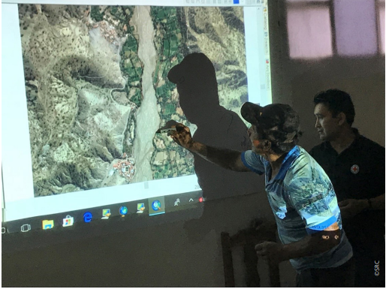
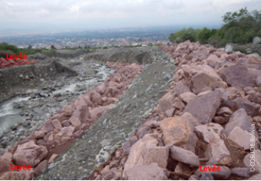
Learning Journey Hazard and Risk Assessment
‘Etiquette’
Plenary sessions are recorded
Keep mic muted, but keep camera on
Opportunities to ask questions by voice and through chat
Welcome

Slide 2
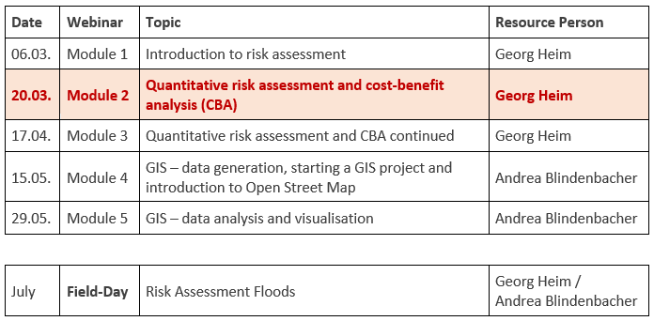
Learning Journey Hazard and Risk Assessment
Part II: Risk Assessment
Objective
Enhance the capacity of practitioners on how to:
independently conduct a risk assessment and determine the cost-benefit ratio of a DRR measure
work with GIS
Agenda

Slide 3
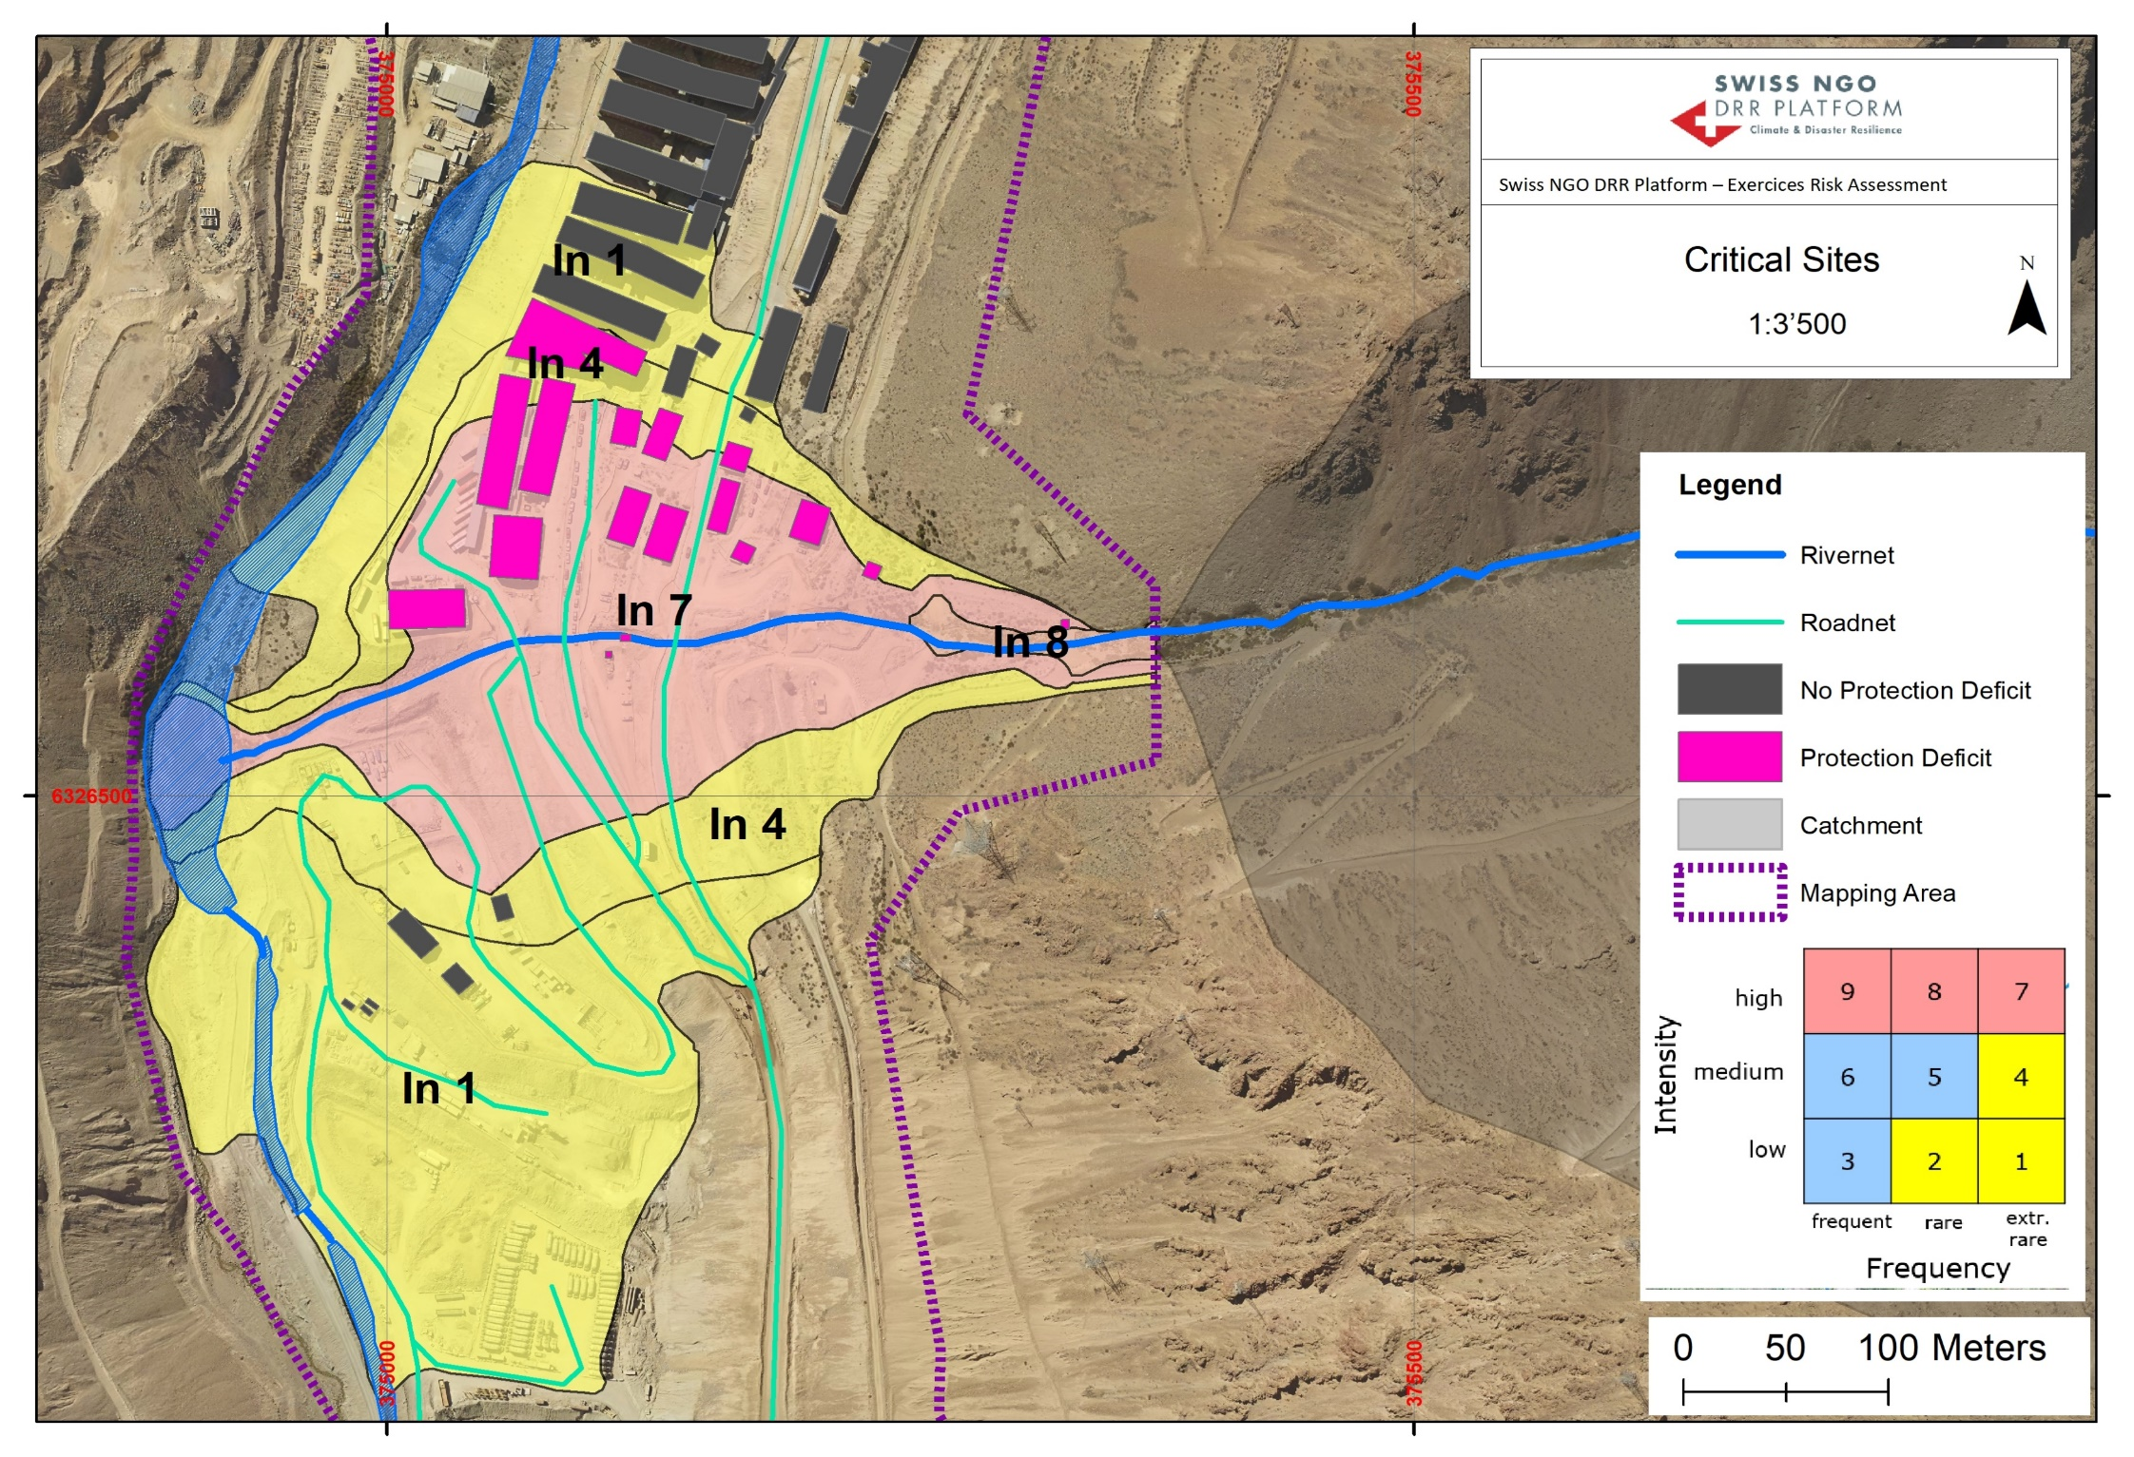
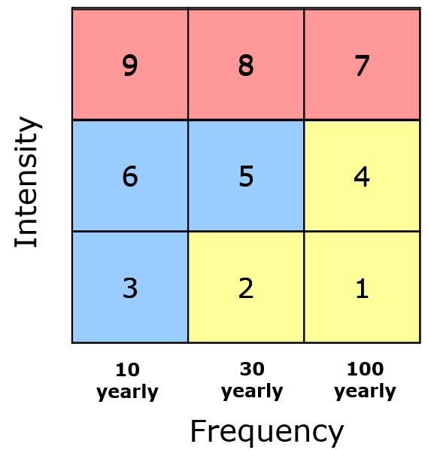
Introduction (Critical sites)
Aprox. 120 persons exposed
Return period of debris flow event 100 years
Destruction of building expected
No options to flee

Slide 4
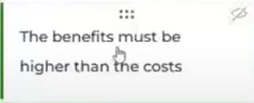
Which are your criteria to decide for mitigation measures?
Criteria:
- Number of affected persons
Costs (measure and assets)
Probability of event
Effect of the measure
Maintenance
Additional criteria:
Intensity of the hazardous process
Resistency of the buildings (physical vulnerability)
Time of stay in hazardous areas
Capacities of persons

Slide 5
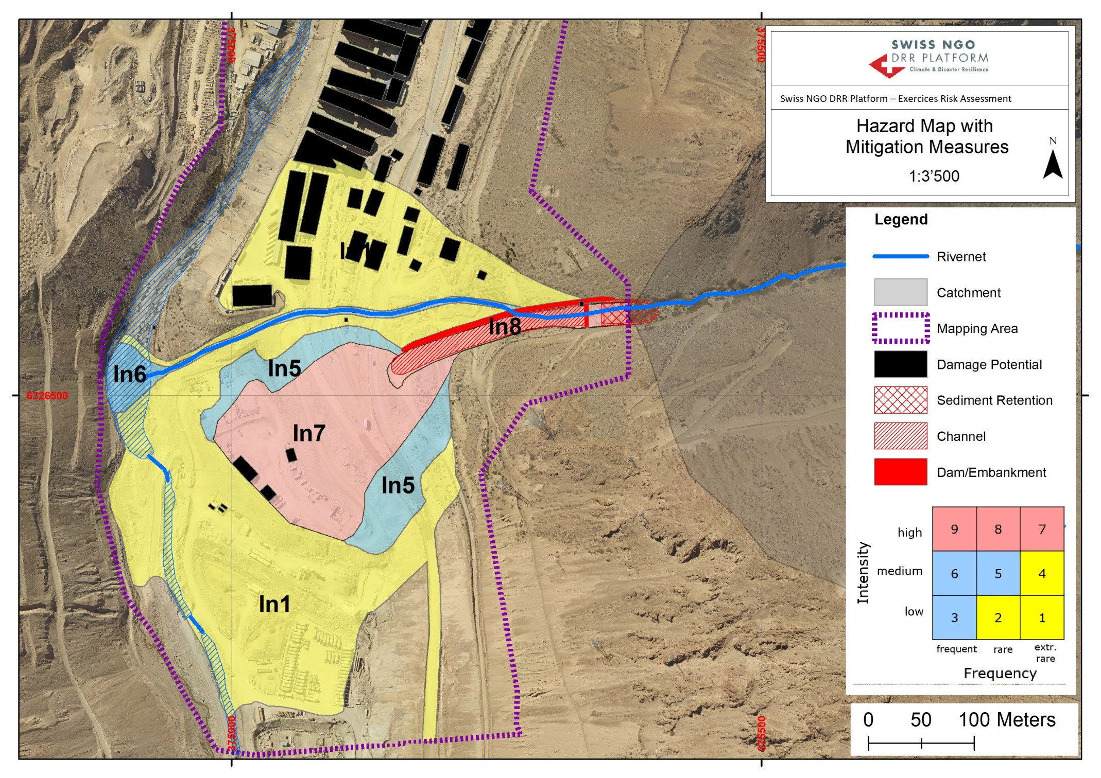
Introduction (Critical sites)
Which maximum amount would you invest for mitigation measures?
→ Chat message

Slide 6
Risk Concept
Expected damage:
5 * 1.000 USD * 0.5 = 2.500 USD
0.25
probability to die = 0.5
(depends on amount of path options)
Definition of Risk:
Expected damage per year [USD/y]
Wolf appears every 10 years
Actual Risk:
2.500 USD/10 years = 250 USD/year
Risk with mitigation measure
(2 additional paths)
5 * 1.000 USD/10 * 0.25 = 125 USD/year
Risk reduction (benefit): 125 USD/y

Slide 7
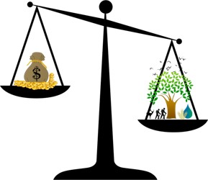
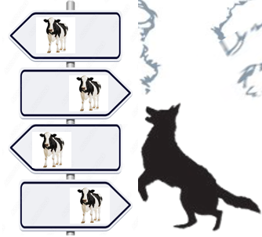
Risk Concept
Cost of mitigation measure: 2.000 $
Lifespan of new paths: 25 years
Cost of measure: 80 USD/year
Risk reduction
(benefit): 125 USD/year
Benefit-cost relation: 1.6

Slide 8
Risk Concept
Probability to suffer damages (Life, Asset, Livelihood)
Probability to die (Mortality):
Probability to die (Mortality):
Type of hazard (flood)
Flow intensity
Physical vulnerability of building
Type of hazard (wolf)
Bite intensity
Number of way options
Agility of people to flee
Daily duration of stay
Functional Emerg.comm.
Early warning system
capacities
0.5
Probability of loss of assets:
Type of hazard
Flow intensity
Physical vulnerability of building
Probability of loss of livelyhood:
Type of hazard
Flow Intensity
Set of capacities

Slide 9
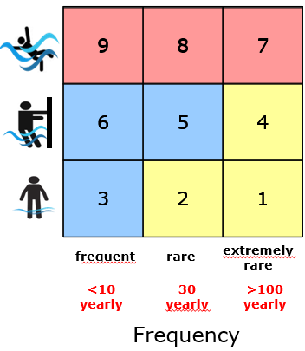
Risk calculation for the actual situation
Main school
Intensity
Physical Vulnerability: 0.5
Object Value: 300.000 USD
Mortality: 0.05
Willingness to pay: 500.000 USD
50 persons in the building
Return Period
Persons
Assets
Exposed time/d (T)
Probability to flee (H)
Physical vulnerability (PhV)
Physical vulnerability (PhV)
+
Object value (OV)
Mortality (M)
Willingness to pay (WP)
R$isk Asset=PhV$ * OV / RP
R$isk Person=$ M * WP / RP * Number People
Notes:
Bsp. Links:
RA: 1500; RP: 12‘500
Bsp. Rechts oben:
RA: 900; RP: 2000
Bsp. Rechts unten:
RA: 10‘000; RP: 25‘000

Slide 10
Group Exercise: Risk calculation for the actual situation
Brick House
Physical Vulnerability: 0.9 (In 7)
Object Value: 100.000 USD
Mortality: 0.1
4 persons living in the house
Intensity
Hospital
Hospital:
Physical Vulnerability: 0.5 (In 7)
Object Value: 2.000.000 USD
Mortality: 0.05
100 persons in the hospital
Return Period
Persons
Assets
Exposed time/d (T)
Probability to flee (H)
Physical vulnerability (PhV)
Physical vulnerability (PhV)
+
Object value (OV)
Mortality (M)
R$isk Asset=PhV$ * OV / RP
Willingness to pay (WP)
R$isk Person=$ M * WP / RP * Number People
Notes:
Bsp. Links:
RA: 1500; RP: 12‘500
Bsp. Rechts oben:
RA: 900; RP: 2000
Bsp. Rechts unten:
RA: 10‘000; RP: 25‘000

Slide 11
Let‘s play a game

Slide 12
Willingnes to pay
How much money should the authorities invest to prevent a death?
Example Bolivia
Aspects to consider
Average age when starting to work | 23 years
Retirement | Average female/male ratio: 58 years
Loss of years of purchase | 35 years
Average salary income | 3.200 USD/y 5.000 USD/a with informal jobs
Average salary income over 35 years | 177.500 USD (formal and informal)
Willingness to pay in your country (in USD)?

Slide 13
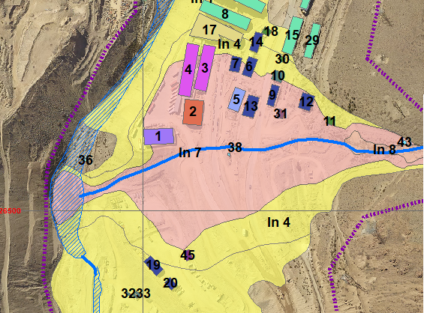
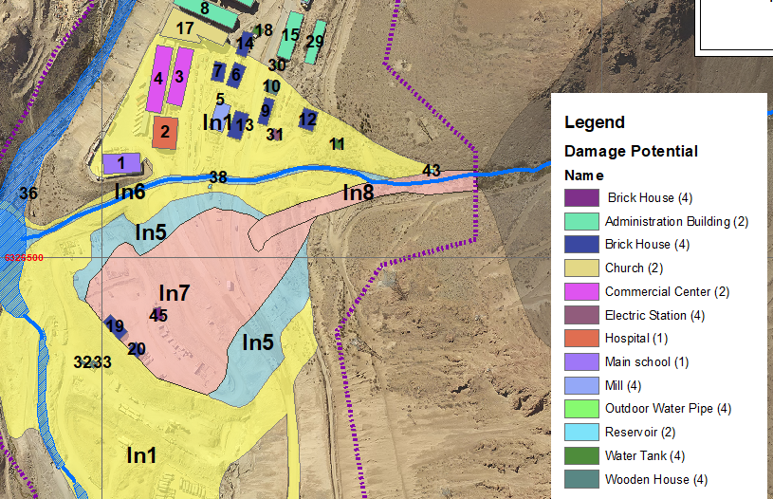
Groupe exercice: Risk reduction for buildings 2, 5 and 17
R$isk Assets=physical vulnerability$ * Object value / return period
Willingness to pay: 500‘000 USD
R$isk Persons=$ Mortality * Willingness to pay / return period * # people

Slide 14
Let‘s play a game

Slide 15
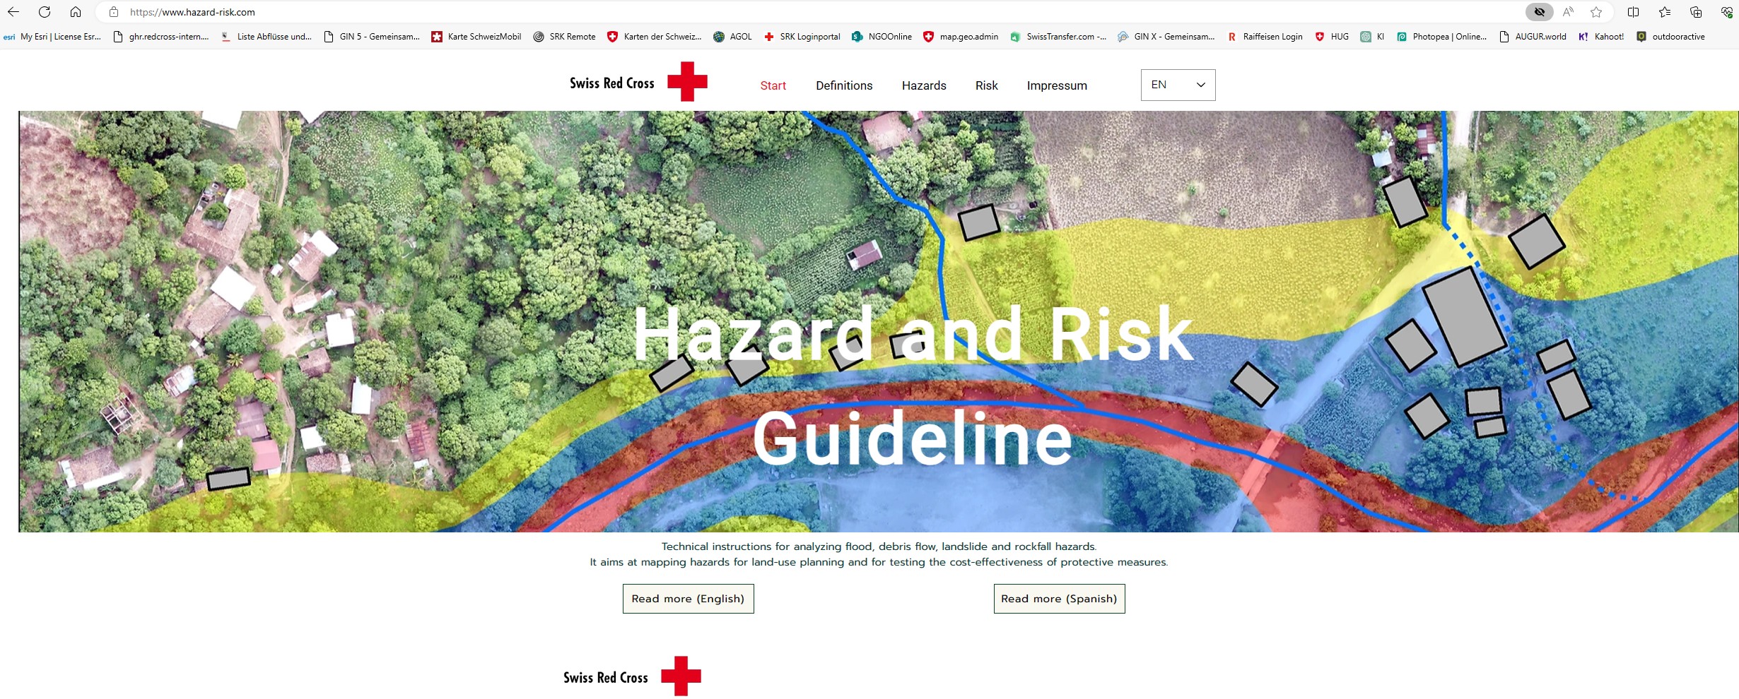
Download the Excel file in the tab „Risk“
www.hazard-risk.com

Slide 16
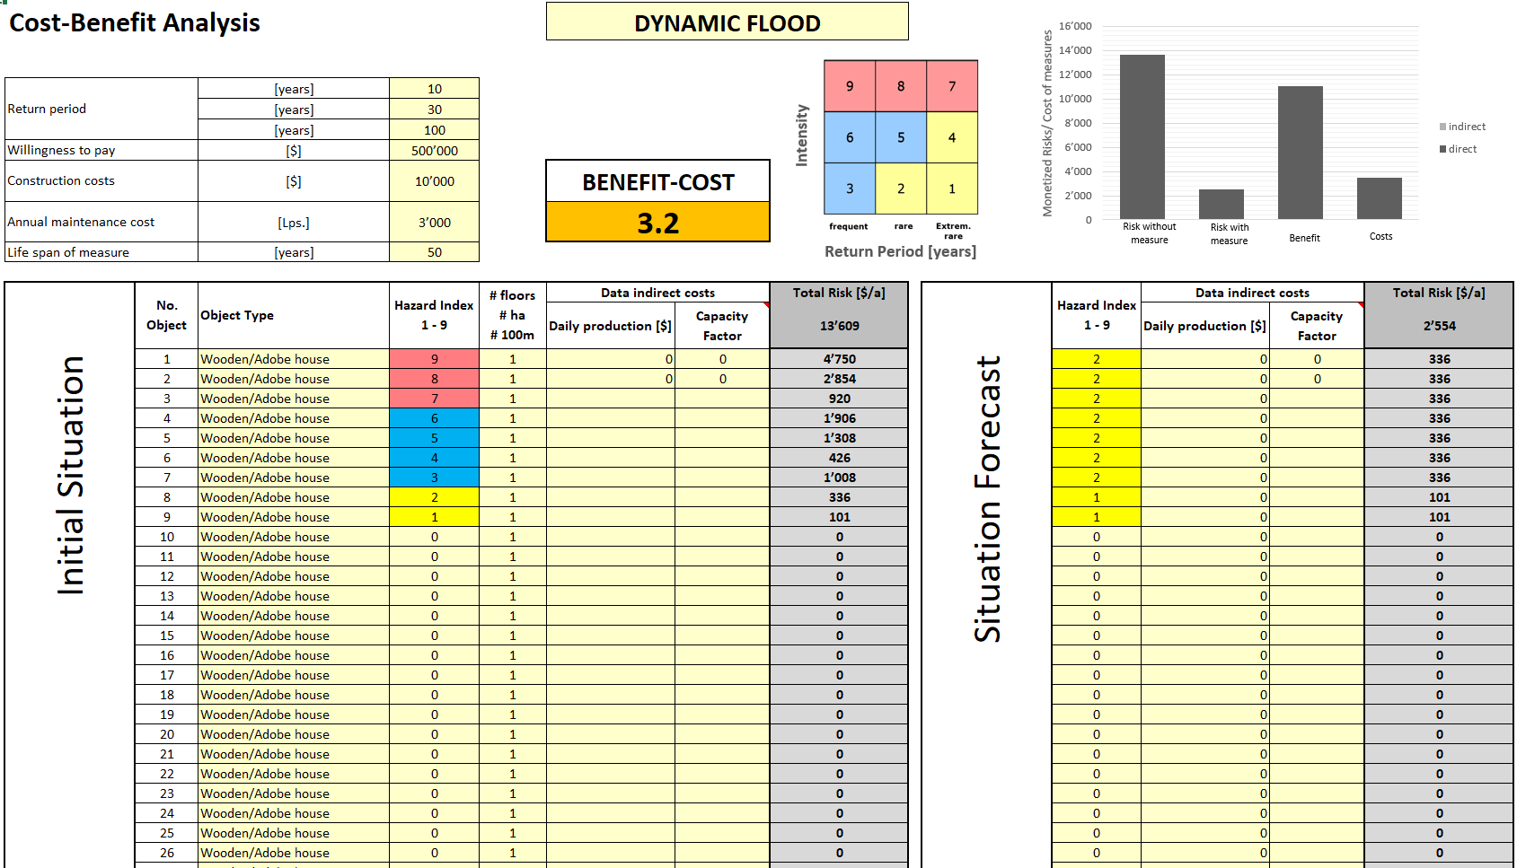
Risk and Cost-Benefit calculation with the Excel-sheet

