Slide 1
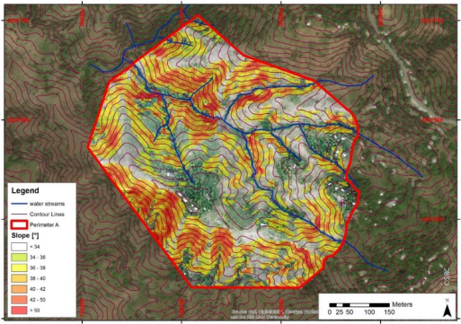
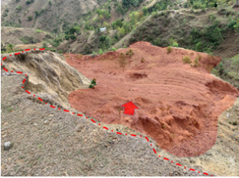
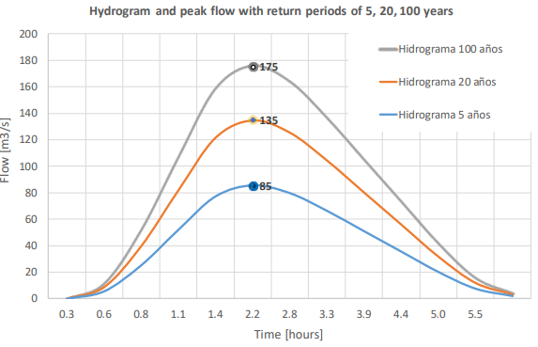
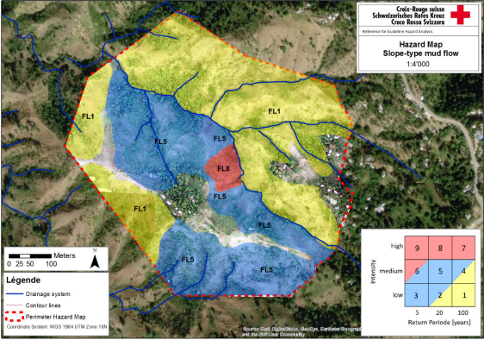
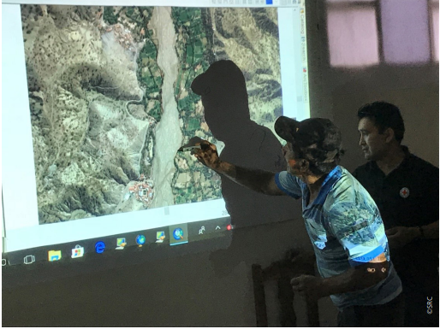
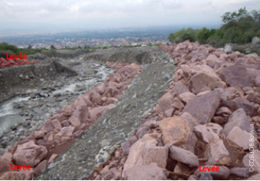
Learning Journey Hazard and Risk Assessment
‘Etiquette’
Plenary sessions are recorded
Keep mic muted, but keep camera on
Opportunities to ask questions by voice and through chat
Welcome

Slide 2
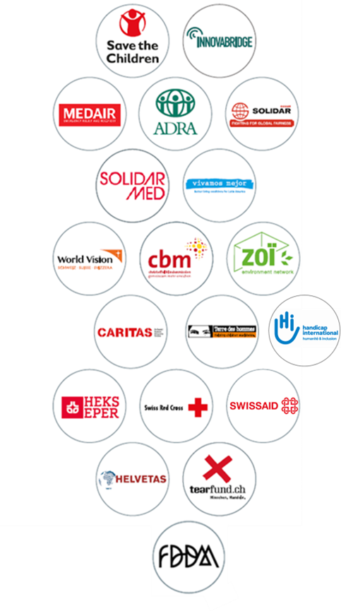
The Swiss NGO DRR Platform
Network of 20 Swiss-based NGOs
“Dedicated to increase the resilience of women and men, communities and governments through DRR and CCA”
3 pillars: Capacity strengthening, conceptual support and advocacy
Partners: Swiss and international
Funding: programme contribution from SDC
Website: www.drrplatform.org
Notes:
The Platform is a network of Swiss-based organisations working on a not-for profit basis. It was founded in 2011, almost 10 years ago, by 7 member organisations and has since steadily increased its membership to 20.
We work on shaping the understanding of disaster risk reduction and climate change adaptation and enhancing the quality of projects among us member organisations, always with the ultimate goal to strengthen the resilience of people, communities and governments. We work on 3 pillars: capacity building through learning and exchange, like this workshop on the humanitarian-development nexus, providing conceptual support – methods and tools – and advocacy and policy dialogue.
During the past years, we steadily increased our partnerships and alliances. We collaborate closely with the Swiss Agency for Development and Cooperation, we also work with several Swiss Universities. Through our membership in GNDR, the Global Network of Civil Society Organisations for Disaster Reduction, and PEDRR, the Partnership for Environment and Disaster Risk Reduction, we are connected at the international level. And through our member organisations, we are closely linked with their own networks, for instance the IFRC, Save the Children, Caritas network and many others.
We are working based on a 4 year programme for which we receive a financial contribution from the SDC. For more information on events or resources, you can always visit our website.

Slide 3
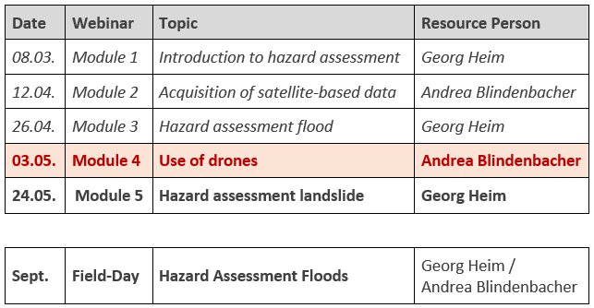
Learning Journey Hazard and Risk Assessment
Part I: Hazard Assessment
Objective
Enhance the capacity of practitioners on how to independently conduct a hazard assessment, including how to retrieve airborne data.
Agenda

Slide 4
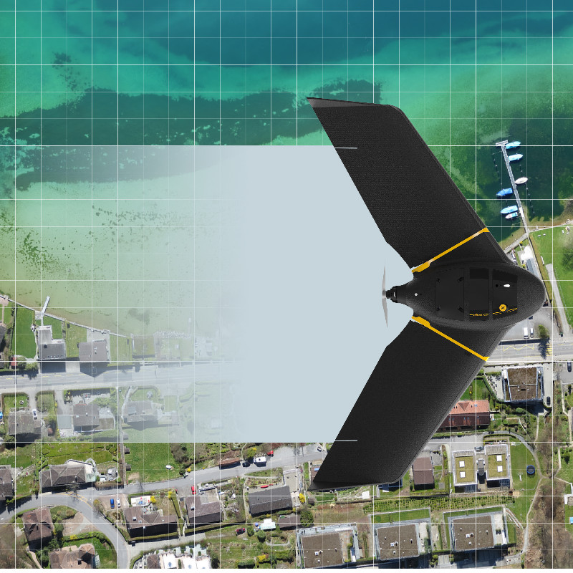
Learning Journey Hazard and Risk Assessment
USE OF DRONES
Notes:
Last week with Georg, we looked at the different tools the Augur platform provides.
From analysing rainfall, to discharge areas and flooding parameters.
And with me a couple of weeks ago, we looked at remote sensing and GIS basics, like raster versus vector data, resolutions, scale, orthos and elevation models.
Today it’s about the use of drones and data processing, where will mainly look at drones used for aerial mapping.

Slide 5
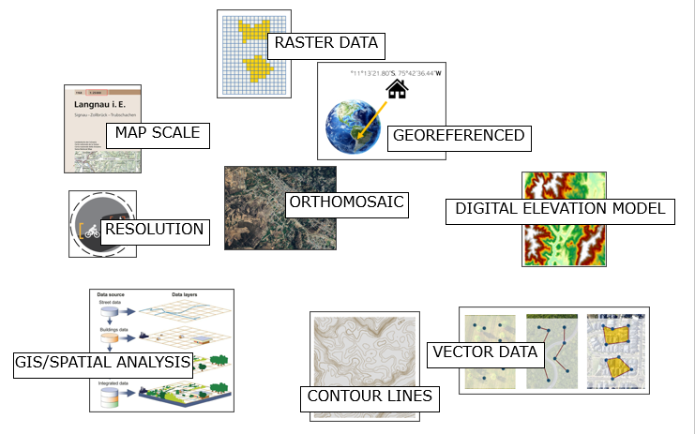
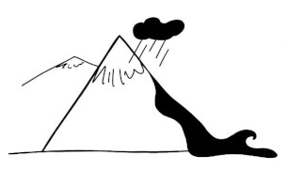
Exercise 1 – Image-Word Puzzle
Image-Word Puzzle

Slide 6
Content
Types of drones
Equipment to fly drones
Data creation with drones (workflow)
Data processing
Application examples

Slide 7
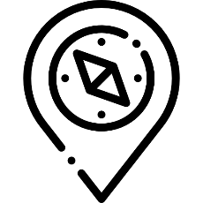
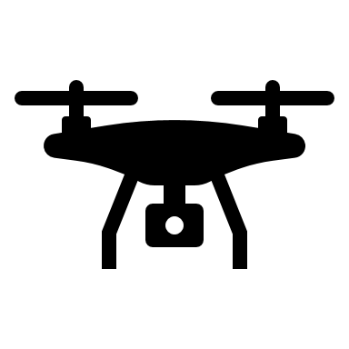
What does it take?
To become a drone pilot:
Notes:
What does it take to be a drone pilot?
If smartphone technology and a bit of tinkering is fine for you, you are ready to go.
Flying a drone might tickle your skills in:
Basic physics (why drones fly), weather forecasting skills, your orientation and navigation skills as well as your camera operating talents.
A certification or license as a drone pilot is necessary if you operate a drone commercially.
In the next step, one needs a drone, batteries, and a controller.
A safe area to fly, with no other air traffic, know the regulations and then start practicing flying skills.

Slide 8
TYPES OF DRONES
Notes:
First, we will look at the types of drones out there. Remember that the drone is just a means of bringing a camera or another sensor up in the air. Other platforms could be aircraft, helicopters, and satellites.
We have in recent years become very inexpensive and accessible to use for aerial mapping and other applications.

Slide 9
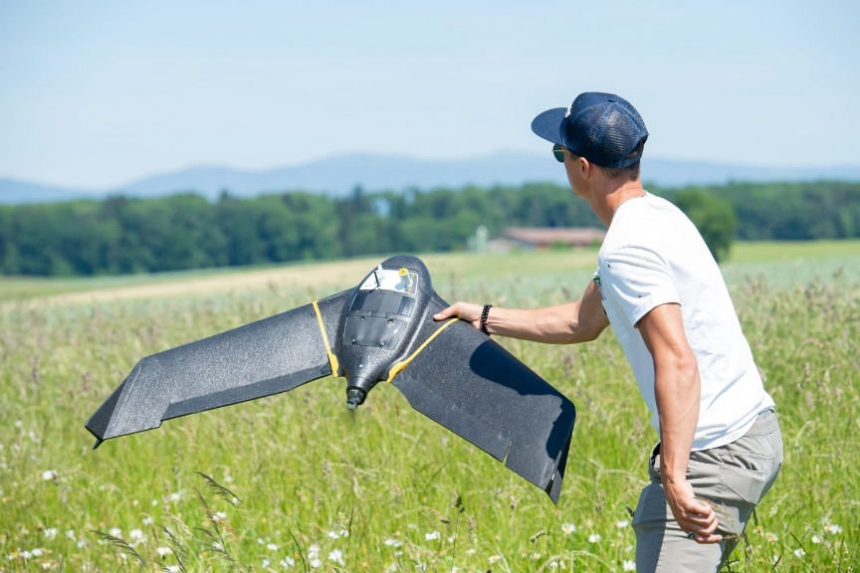
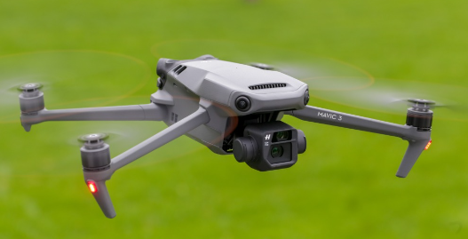
Types of drones
Fixed wing
Copter drone
VTOL fixed wing
Notes:
There around 3 types of drones, copters, fixed wing and vtol fixed wing drones. Vtol stands for vertical take off and landing.
These drone types are mainly different in their flight behaviour.
Fixed wing drones, like airplanes, use 1 wing or also 1 airfoil to fly and usually have 1 propeller for forward motion. They are launched by throwing them up in the air by hand.
Copter drones, have either 2 propellers like a helicopter, or then 4 to 6 propellers. These take off and land vertically and can hover.
VTOL drones, where technically one has to say VTOL fixed wing drones, have a couple of propellers to take off like a copter drone and once at a certain altitude will switch to fixed wing flight mode, by repositioning some of it’s propellers or tilting it’s entire body.
Let’s look at the properties of each type of drone.

Slide 10
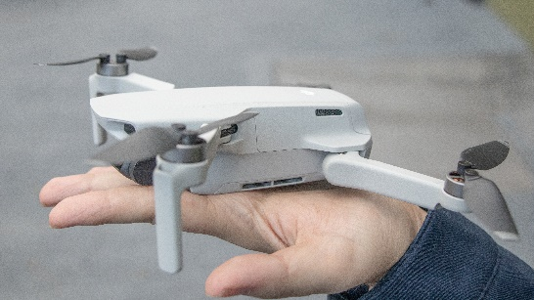
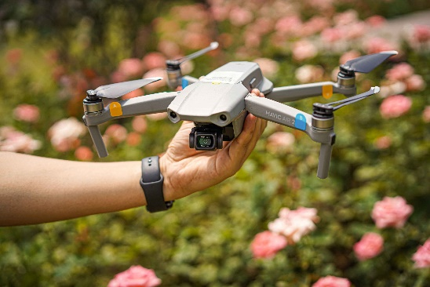
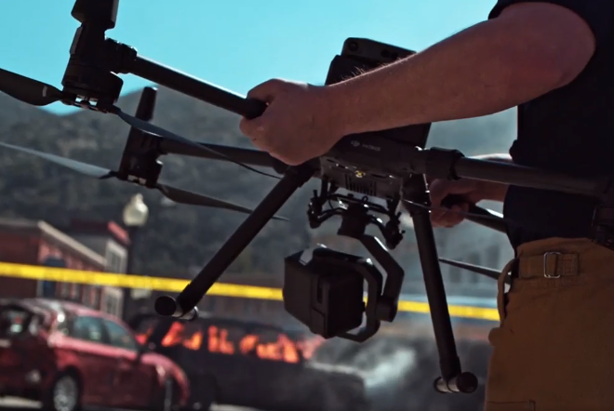
Types of drones: Copters
Costs: 100.- - 100’000.-
Flight times: 10 - 30 min
Weight: 100g – 15kg and heavier
Wind resistance: 20 m/s, 72km/h
Mapping area coverage:
Speciality: Can hover in a certain position
Applications: Inspection, Search & Rescue
Notes:
Copters

Slide 11
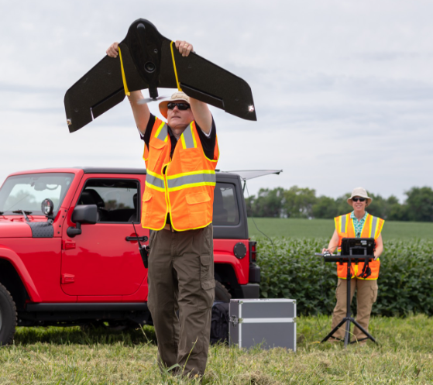
Types of drones: Fixedwing
Costs: 20’000.-
Flight times: 90 min
Weight: 2kg
Wind resistance: 17 m/s, 61 km/h
Mapping area coverage: 250 ha @ 120m AGL
Speciality: coverage
Applications: Wide are mapping
Notes:
Copters

Slide 12
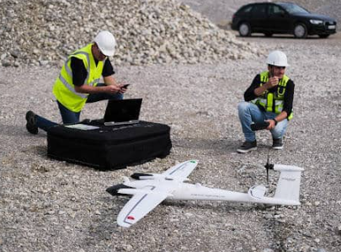
Types of drones: VTOL Fixedwing
Costs: 20’000.-
Flight times: 90 min
Weight: ~4.5 kg
Wind resistance: 17 m/s, 61 km/h
Mapping area coverage: 4 km² @ 120m AGL
Speciality: coverage & vertical take-off and landing
Applications: Wide area mapping
Notes:
Copters

Slide 13
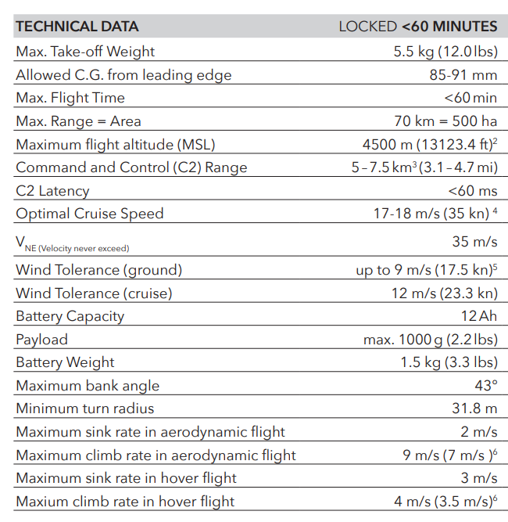
Respecting Operational Limitations
Notes:
Ultimately anything that flies adheres to some basic physical laws like lift, thrust, drag and gravity. These forces always have to be within a certain balance. If an imbalance occurs the flight becomes turbulent, increasing the imbalance until ultimately the structure of the flying object fails.
These limits are also called operational limitations and they are described in the specifications of each drone user manual.
But also in many cases the drone’s autopilot and sensors can detect if such limits are reached and either give the user a warning or even execute a safety action completely automatically.

Slide 14
EQUIPMENT TO FLY DRONES

Slide 15
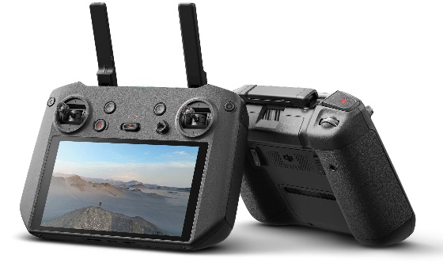
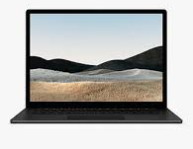
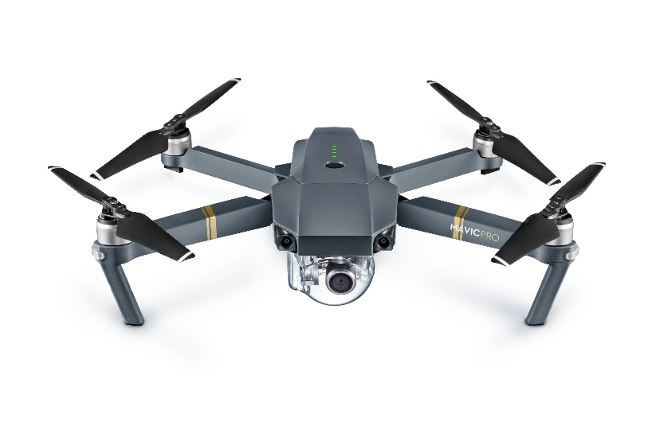
Equipment
Ground control station
The processing station
Drone
Communication via Radiolink
Data transfer:
Wireless, wire or SD-Card
Notes:
What you need to fly a drone:
The ground station:
You need a controller with the flight planning and flight execution software on it.
This can come as fully integrated or as a controller that attaches to your phone and the software runs on your phone
Or then you are required to have your own laptop or tablet on which the software to plan and fly is installed.
The drone:
Which includes the frame, removable propellers, if not integrated a camera and storage device like an SD-Card.
And of course batteries.
The Processing station:
A computer with enough CPU, RAM and storage to process the data. Plus the required processing software.
Or then a tablet or computer with internet access to upload the collected images onto a cloud processing software.

Slide 16
Regulations
Be aware of:
Privacy
Avoid controlled airspace
Avoid airports (5km radius)
Stay within VLOS (Visual Line Of Sight)
Stay below 120m / 400ft above ground
If the drone is >250g, have:
- A Drone pilot license
- A liability insurance
Notes:
Regarding regulations, the world is still wild around regulating drone flying.
The most important to be aware of are:
Privacy
Avoid controlled airspaces and areas within 5km of an airport
Avoid flying over people
Avoid tourist sites or get the authorization
It’s the country’s Civil Aviation Authority’s role to regulate drone flights.
In Europe, EASA has established rules that are now valid everywhere.
However, if you want to fly or get a permit, this would still go through your local CAA.
It is important to have a drone pilot’s license if the drone is heavier than 250g. This is true for most countries.
And it’s also wise to have liability insurance.

Slide 17
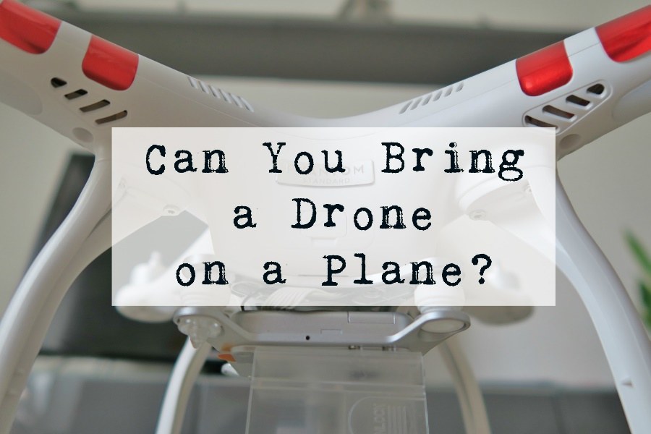
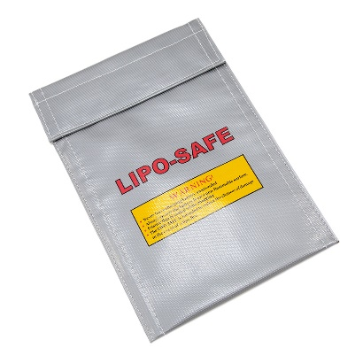
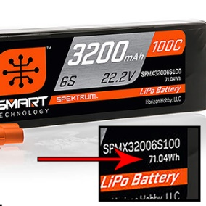
Travelling with Drones
Drone in check-in luggage (hard case)
Batteries in hand luggage inside a Lipo bag
LiPo batteries below 100 watt hours don’t require approval.
mAh/1000 x V = Watt-hours

Slide 18
DATA CREATION WITH DRONES

Slide 19
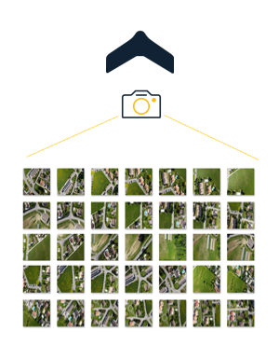
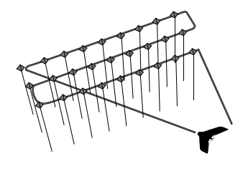
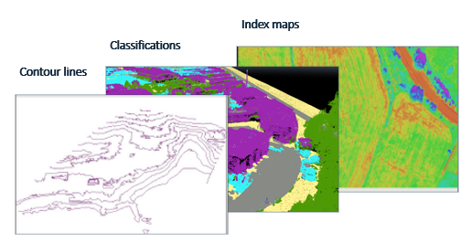
Data creation with drones
PLAN
FLY
PROCESS
ANALYSE
Notes:
In order to create the basic data for our hazard and risk assessment like discussed in the 2nd session: orthomosaic, elevation models, dsm dtm etc.
The drone, the flying process and the data harvesting and processing must be done in a specific way.
1st the drone must be equipped with a suitable camera.
2nd the flight program has to be such that images overlap at least 60%.
3rd after the flight the images need be processed to correct for distortion and know their XYZ position at which they have been taken.
4th this data has then to be processed by photogrammetric software on a decently powered computer
Let’s look at these steps in more detail

Slide 20
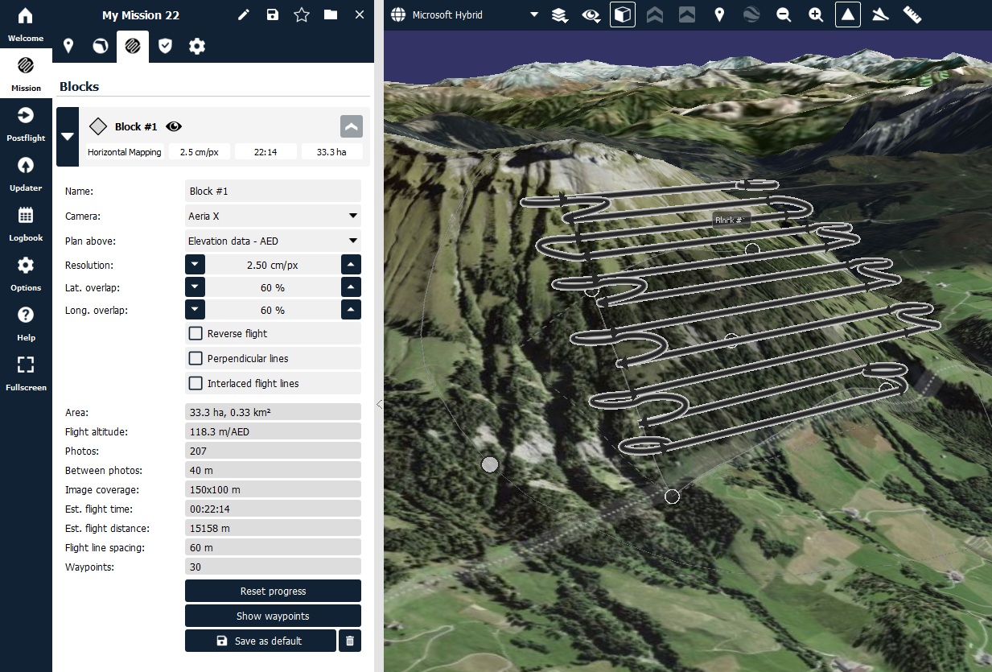
Planning a mapping flight
FLIGHT HEIGHT
DURATION OF THE FLIGHT
Notes:
Demo in eMotion flight planning software.
The conclusions of the planning should be an awareness of the flight height and duration. Duration is important to understand how many batteries are required to cover the area.
The amount of data collected is also interesting, but it’s best to always take off with an empty storage and back available.

Slide 21
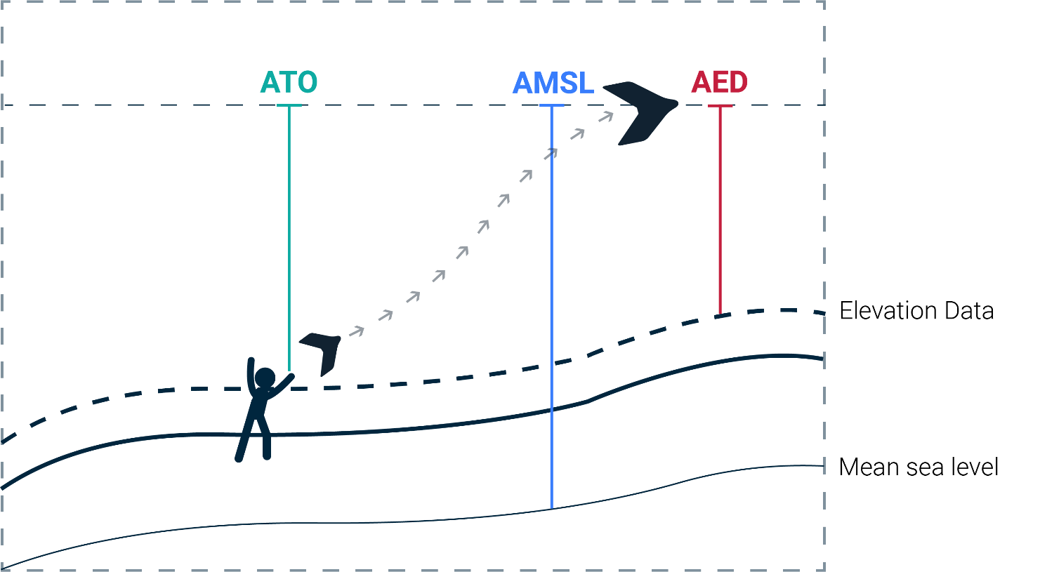
Planning a mapping flight
ATO = Above Take Off altitude
AMSL = Above Mean Sea Level altitude
AED = Above Elevation Data altitude

Slide 22
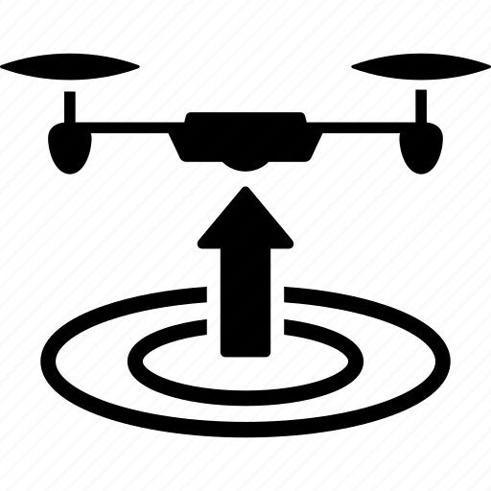
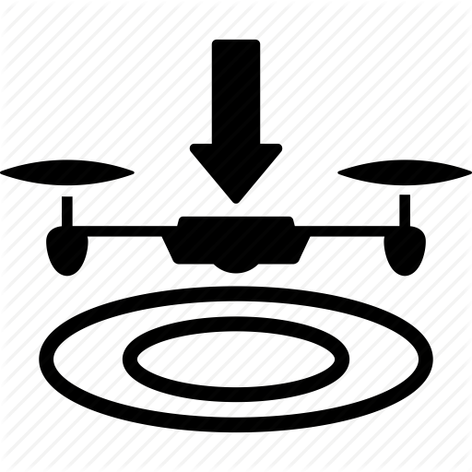
The Flight
TAKE-OFF
FLIGHT
LANDING
Notes:
Small demo emotion if there is time.

Slide 23
DATA PROCESSING

Slide 24
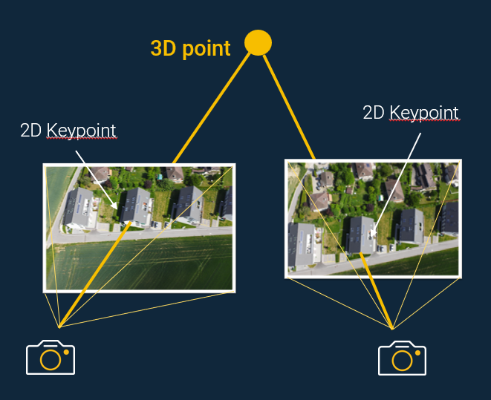
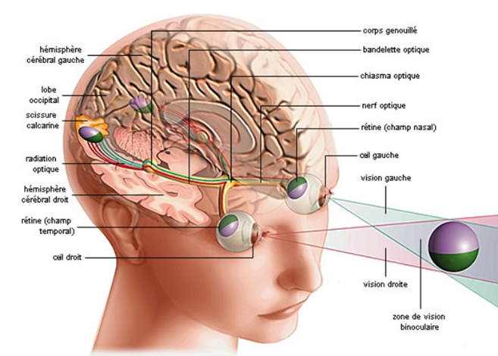
Photogrammetry: From 2D to 3D
Photogrammetry is primarily concerned with making precise measurements of three-dimensional objects and terrain features from two-dimensional photographs.
Triangulation
Stereoscopy

Slide 25
Exercise
Demo + Follow me (Optional)

Slide 26
Processing
Processing hardware:
Project Size:
Notes:
https://support.pix4d.com/hc/en-us/articles/115002439383-Computer-requirements-PIX4Dmapper

Slide 27
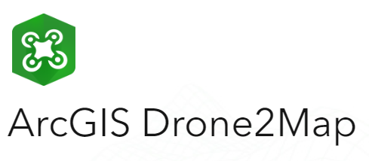
Software options
Notes:
https://geo-matching.com/

Slide 28
APPLICATION EXAMPLES

Slide 29
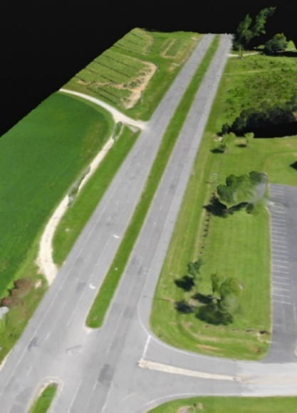
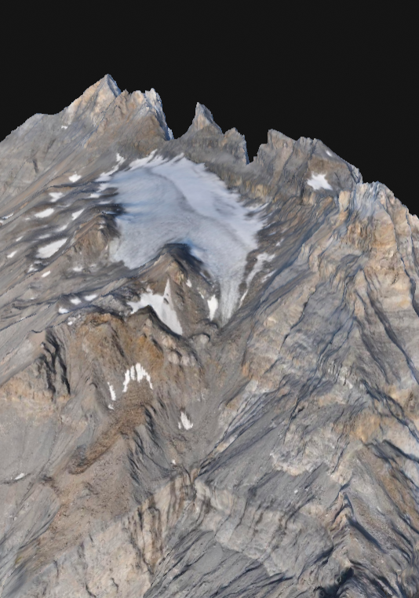
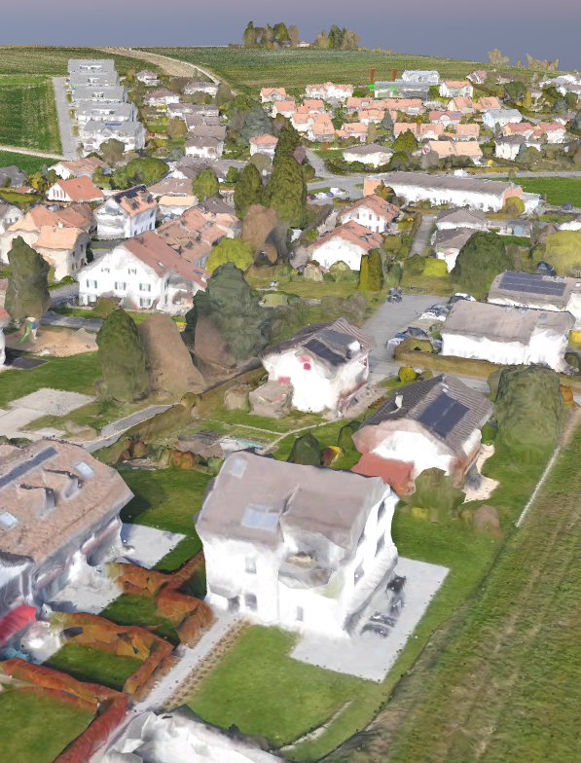
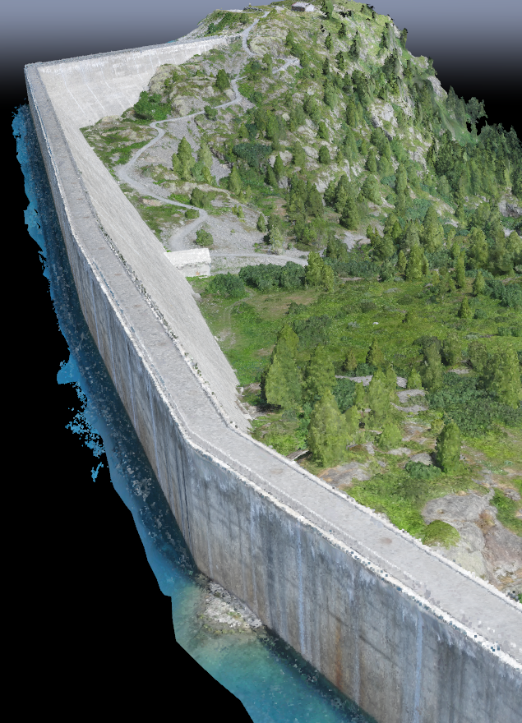
Surveying
With RGB data delivering centimeter accuracy and high precision.

Slide 30
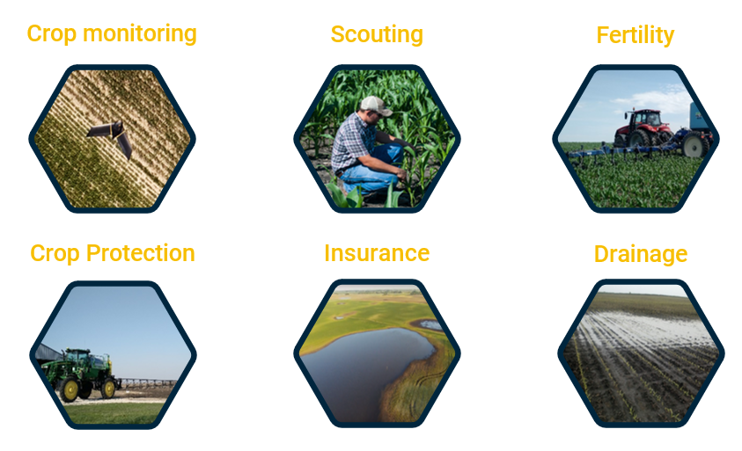
Agriculture
With multispectral data, understanding the state of plants and act upon the conclusions.
Notes:
In agriculture, multispectral imagery is interesting, since the reflection of the plants in the near infrared part of the spectrum unveal information about the health state of the plants.

Slide 31
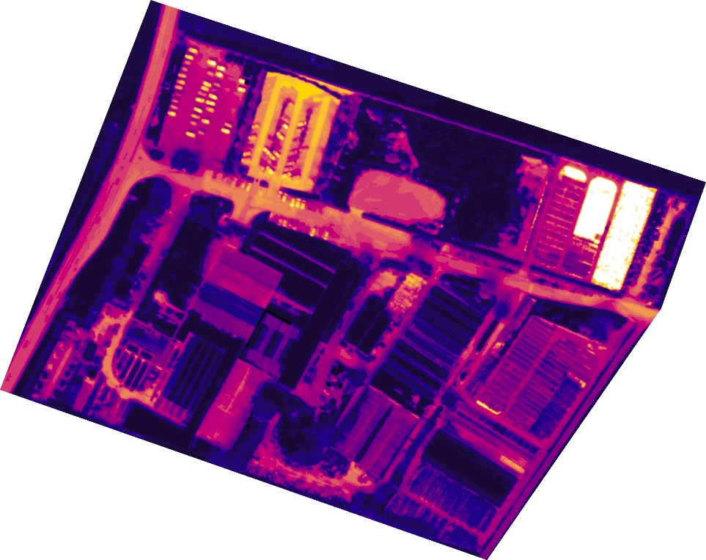
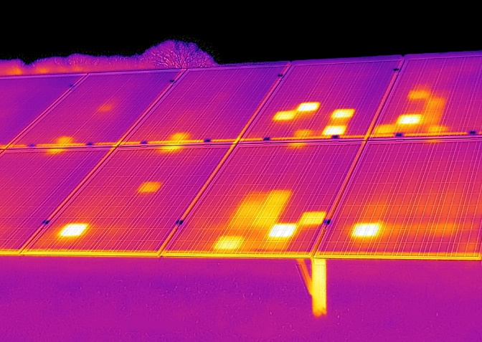
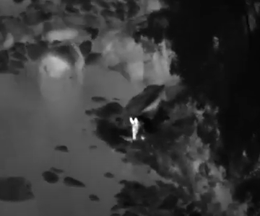
Solar, Heat loss, Search & Rescue
With thermal data, finding hot spots.

Slide 32
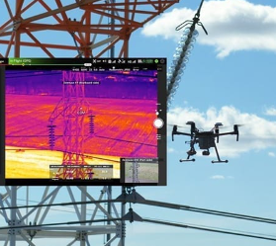
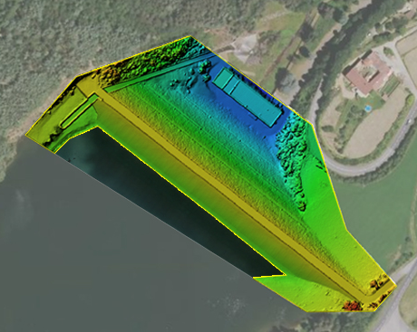
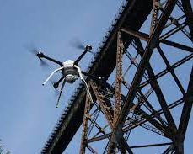
Infrastructure monitoring
With drone data (images & video), doing maintenance analysis

Slide 33
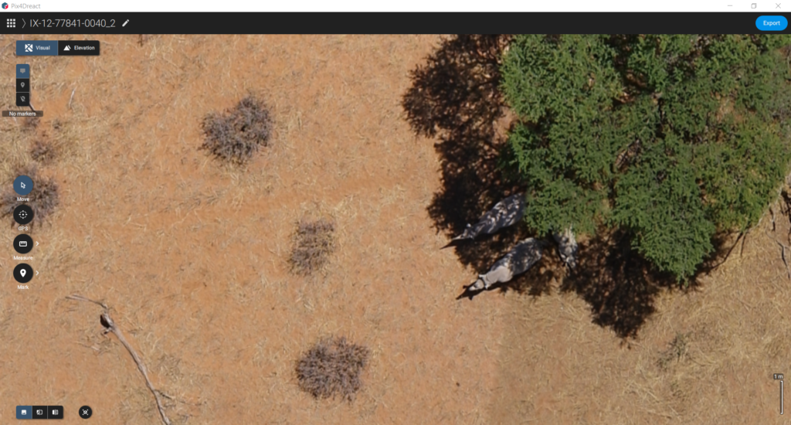
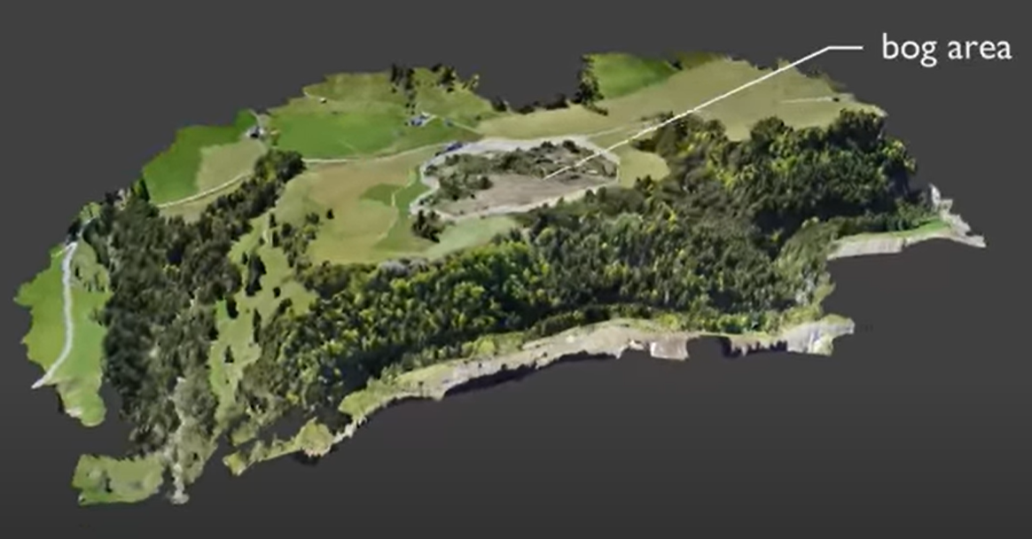
Wildlife, Land cover, surface changes

